Slide 1


Slide 2
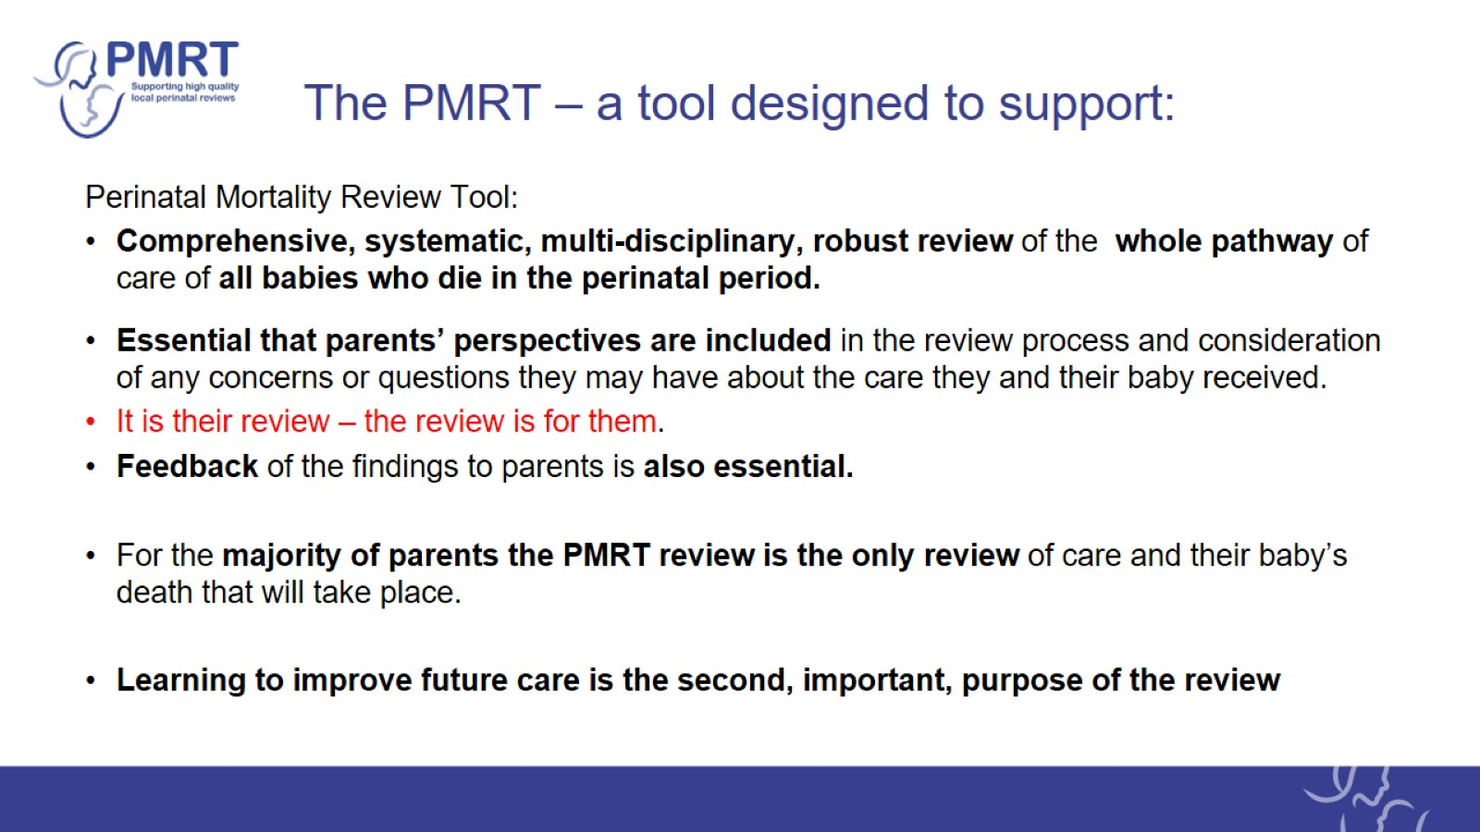
The PMRT – a tool designed to support:

Slide 3
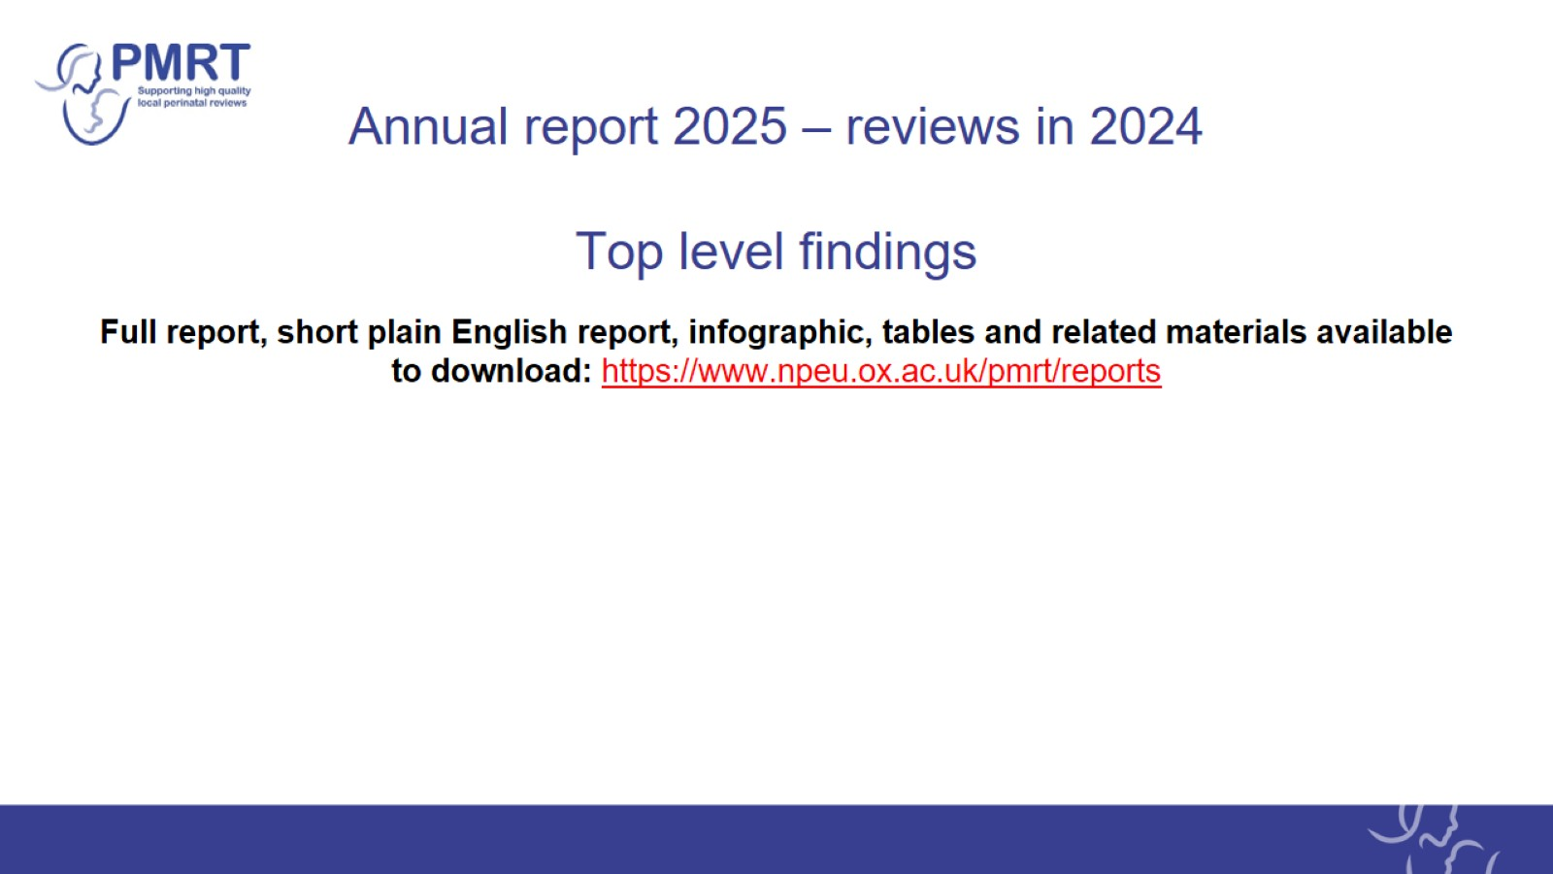
Annual report 2025 – reviews in 2024
Top level findings

Slide 4
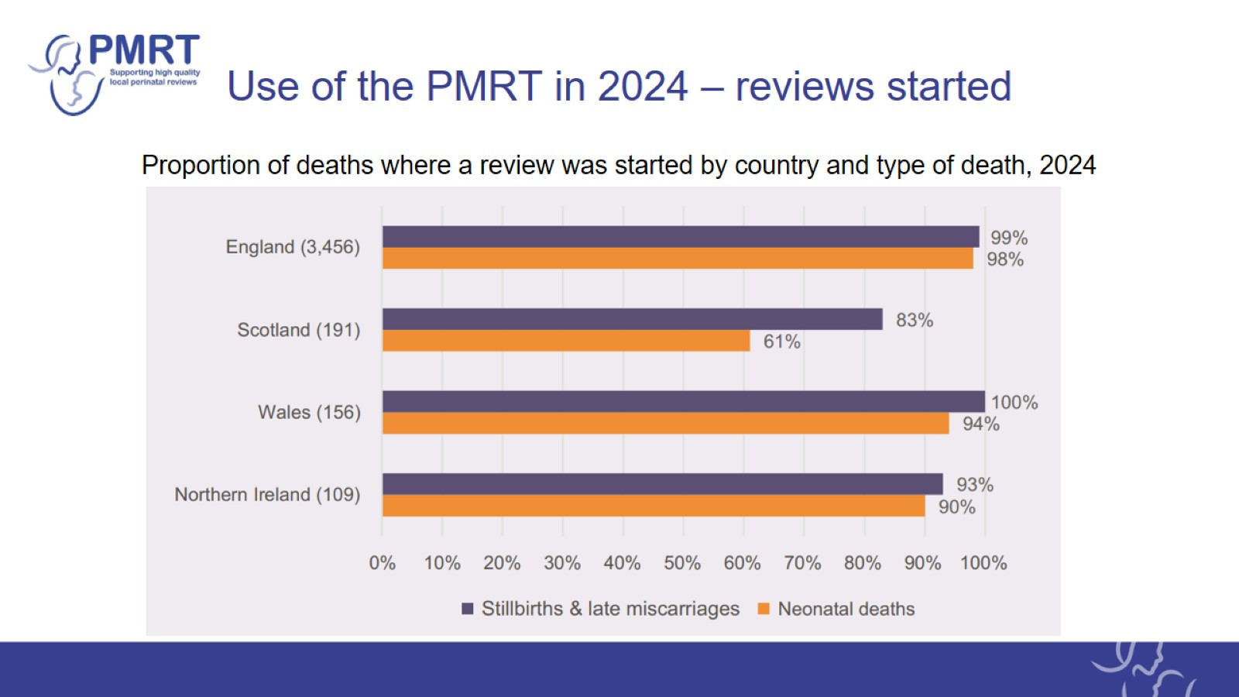
Use of the PMRT in 2024 – reviews started

Slide 5
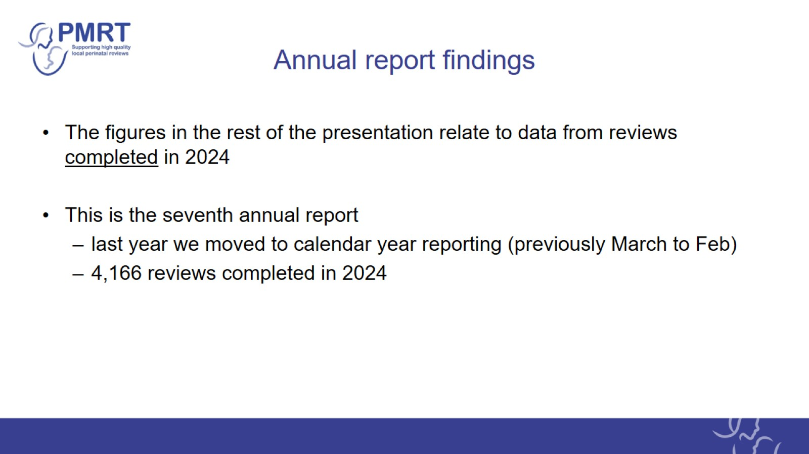
Annual report findings

Slide 6
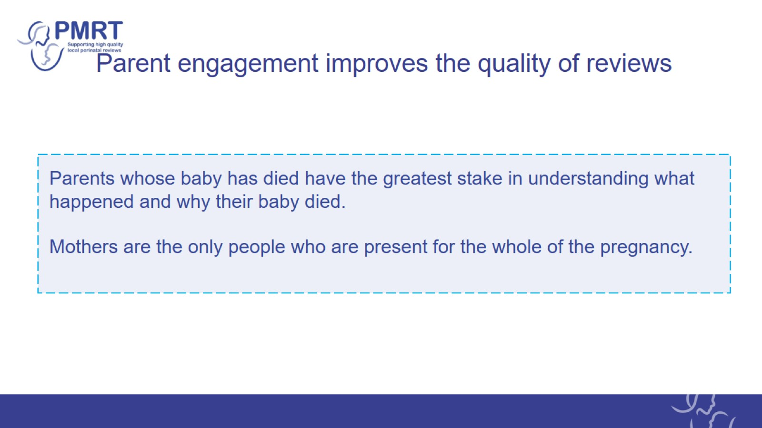
Parent engagement improves the quality of reviews

Slide 7
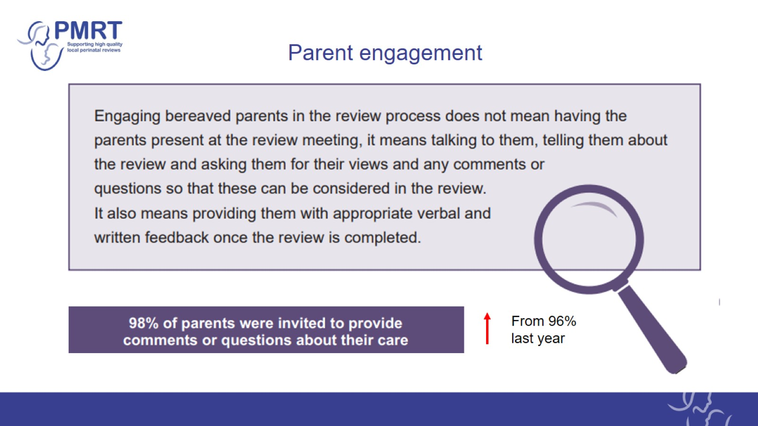
Parent engagement

Slide 8

Parents’ comments and questions about their care

Slide 9
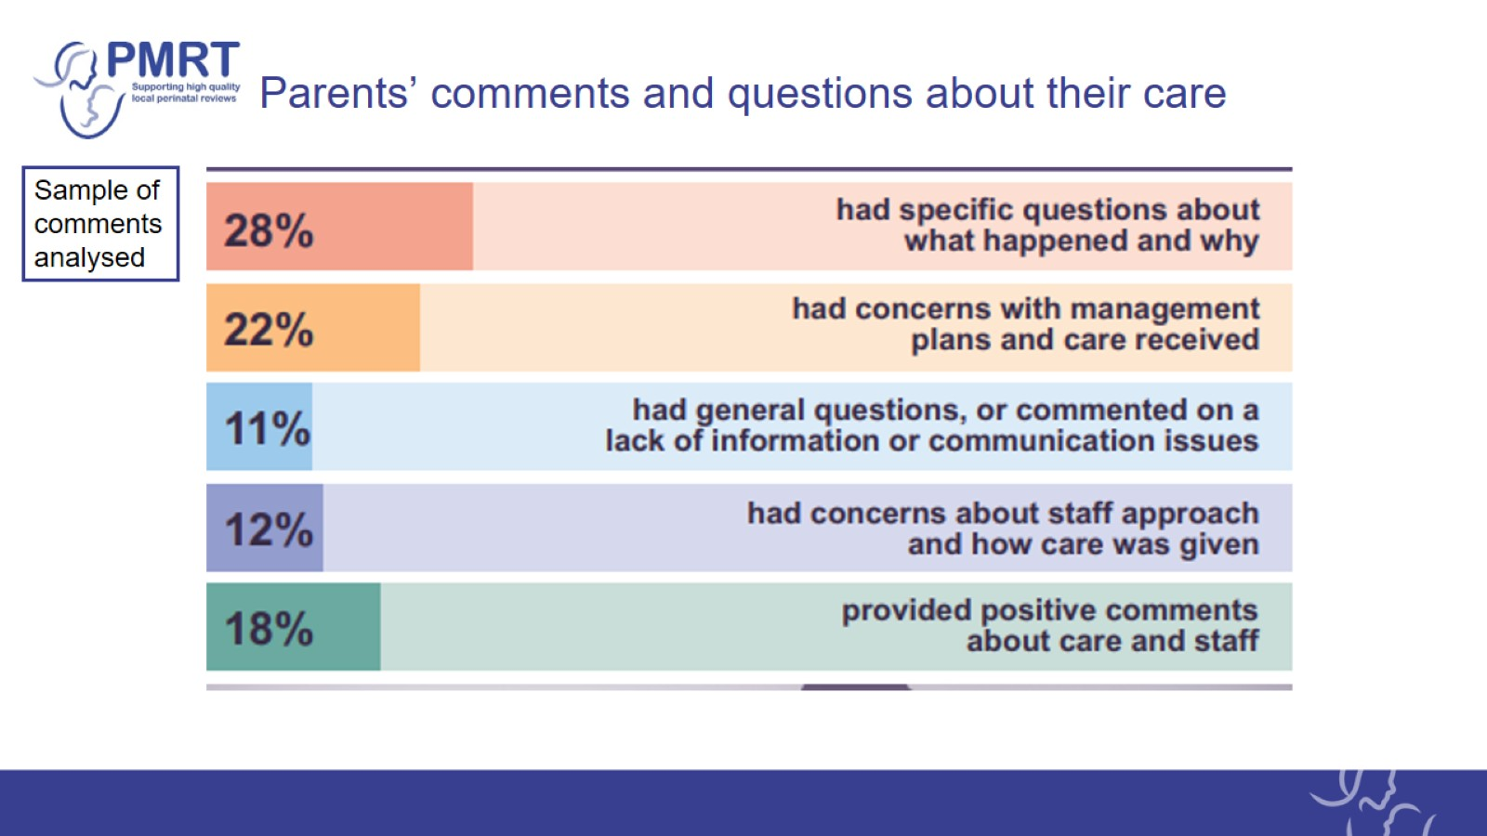
Parents’ comments and questions about their care

Slide 10
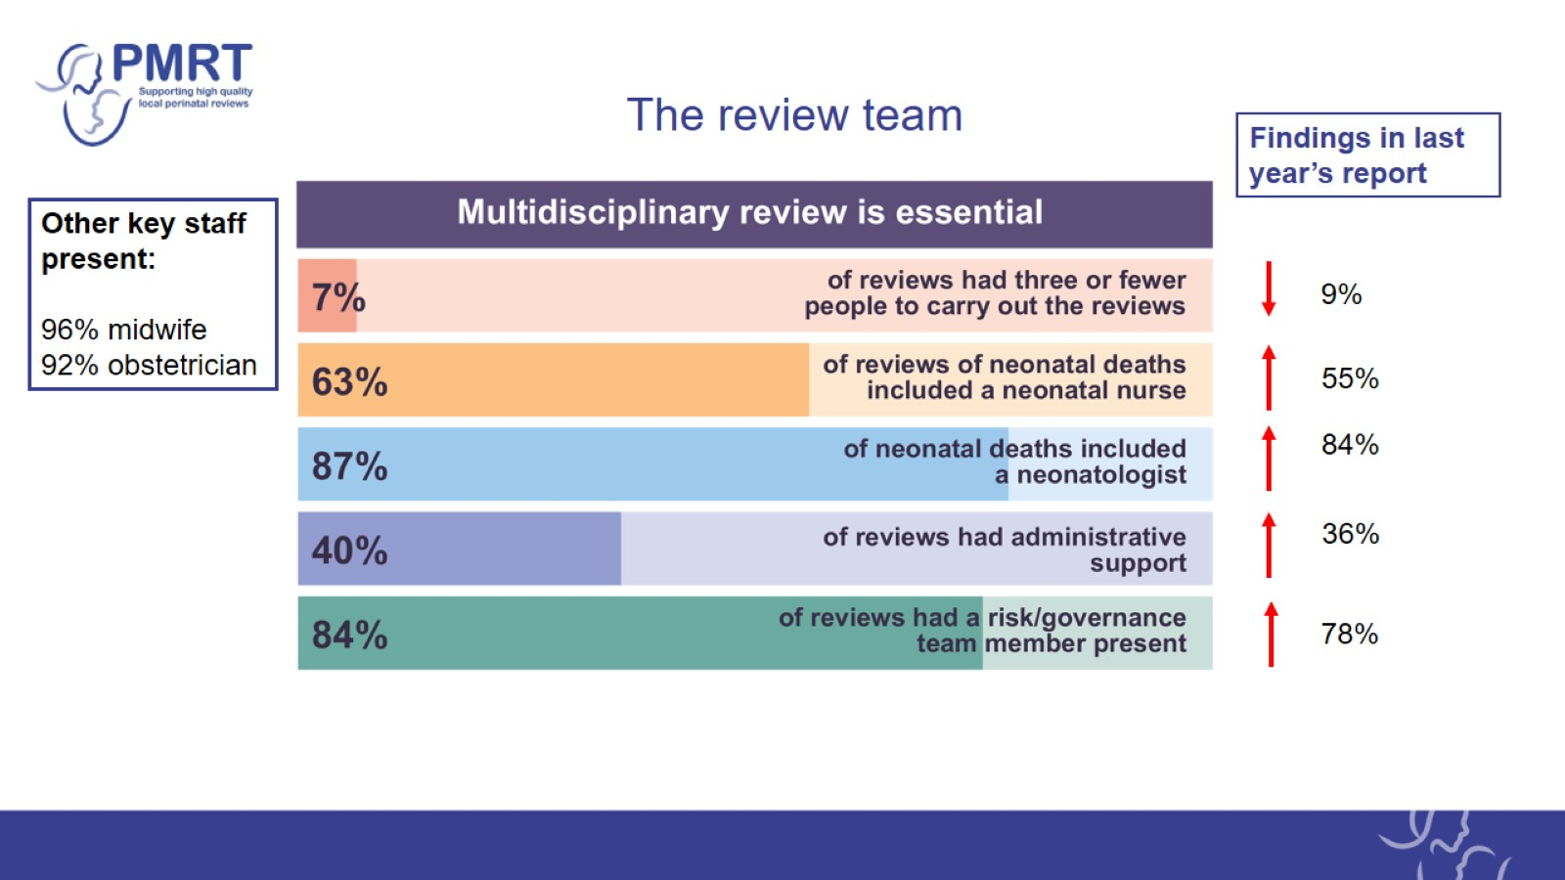
The review team

Slide 11
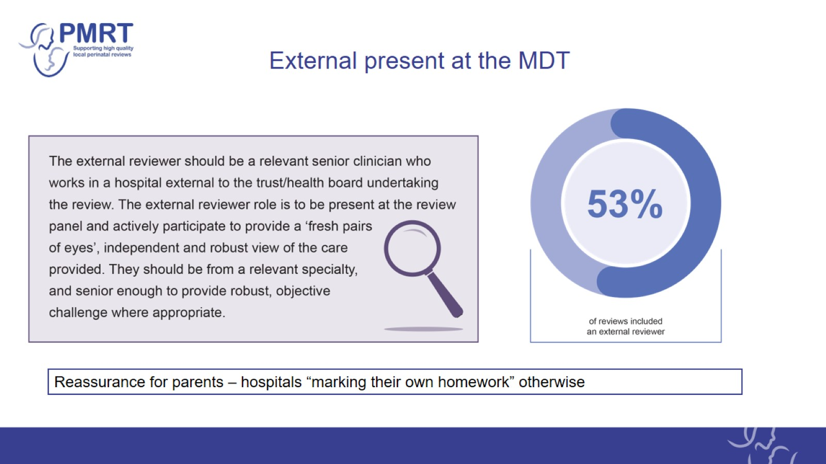
External present at the MDT

Slide 12
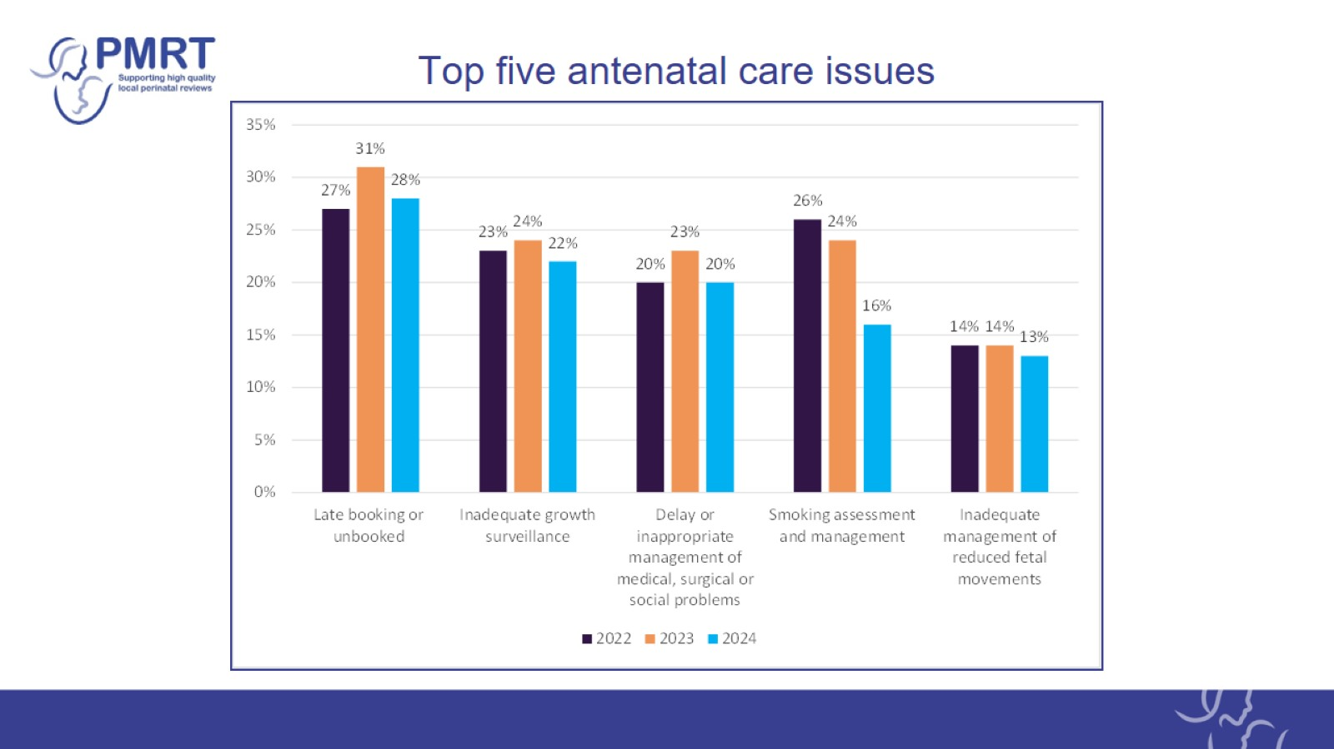
Top five antenatal care issues

Slide 13
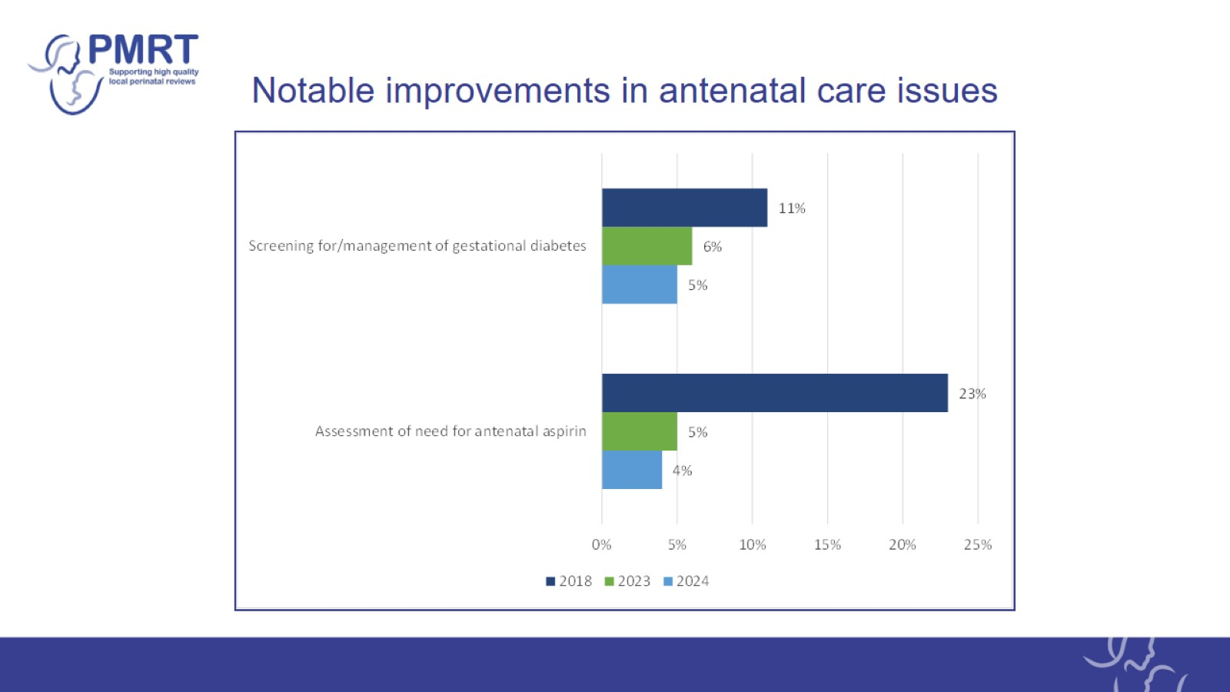
Notable improvements in antenatal care issues

Slide 14
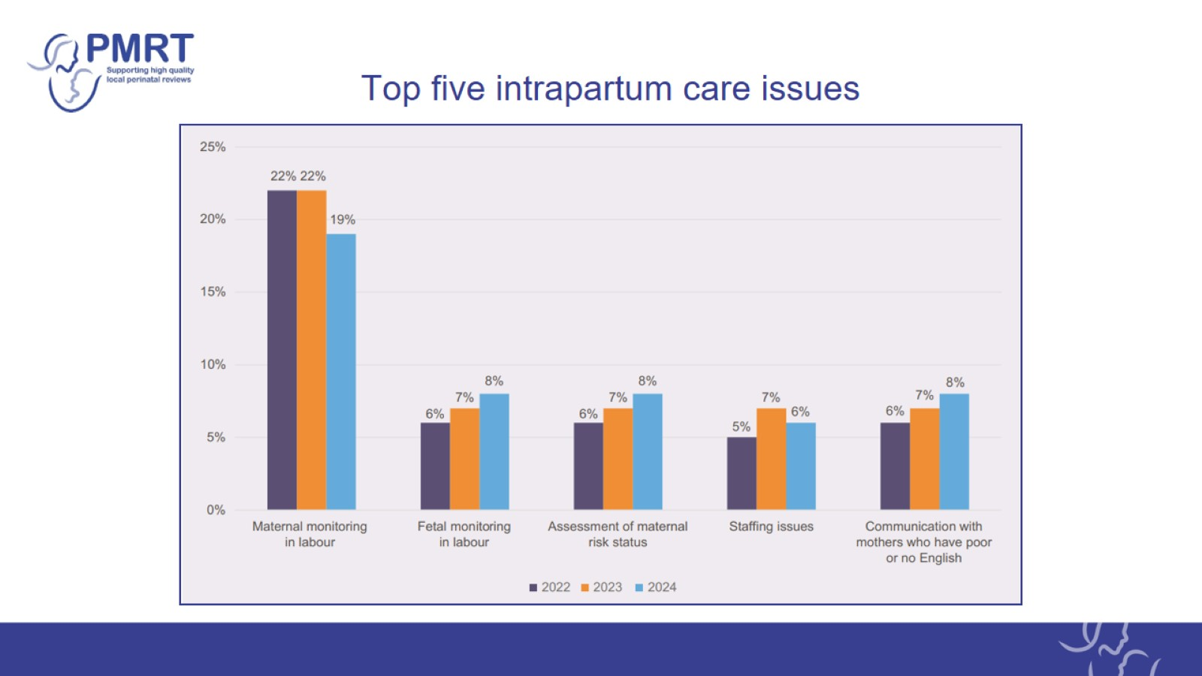
Top five intrapartum care issues

Slide 15
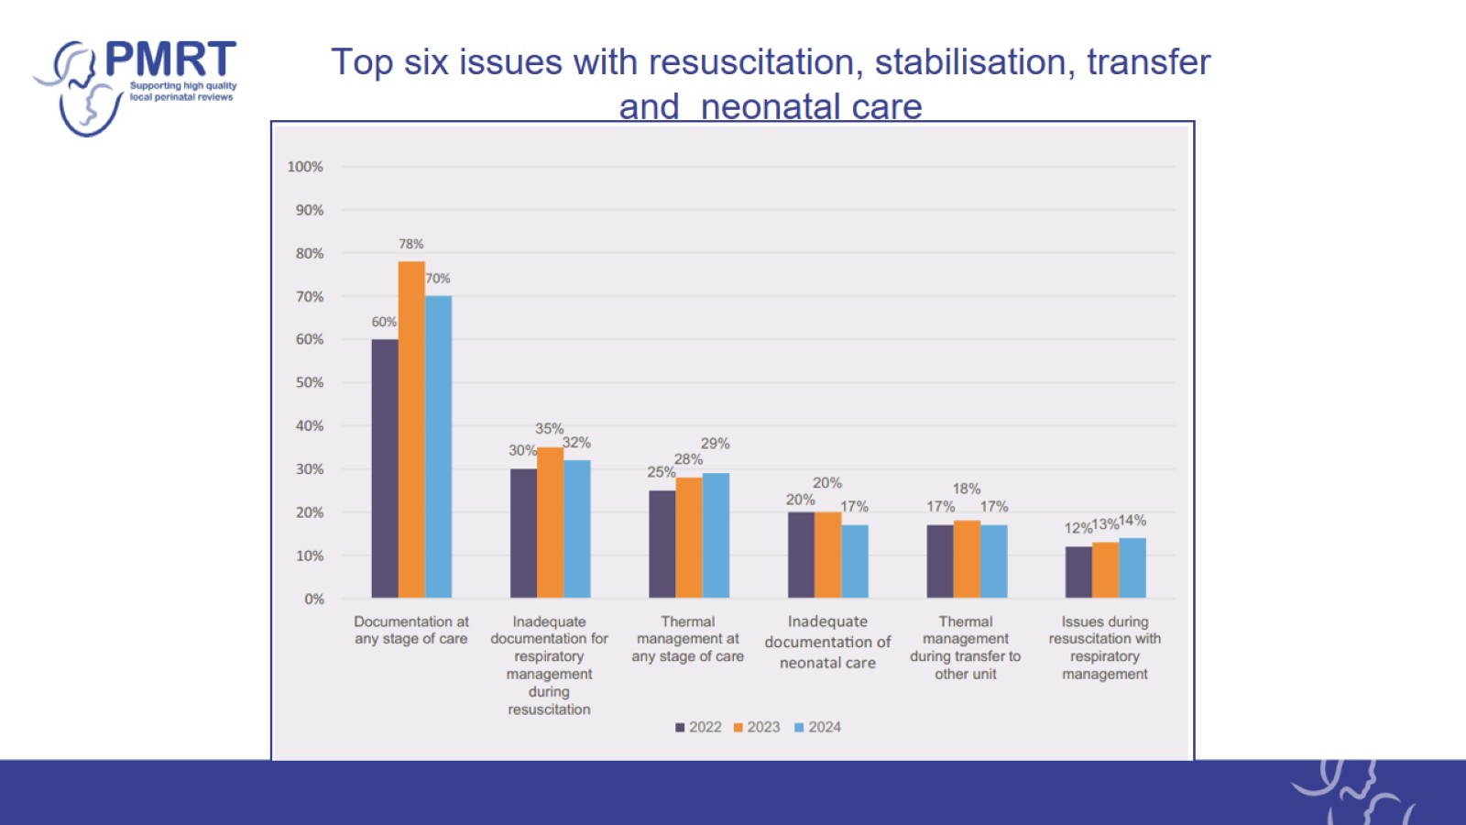
Top six issues with resuscitation, stabilisation, transfer and neonatal care

Slide 16
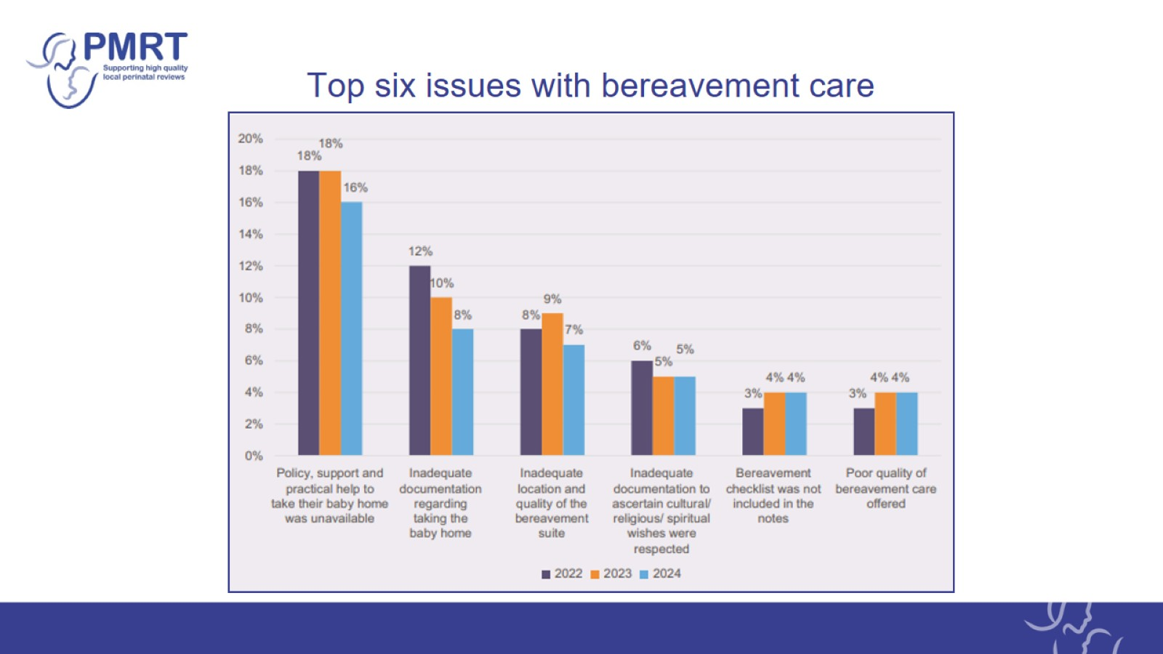
Top six issues with bereavement care

Slide 17
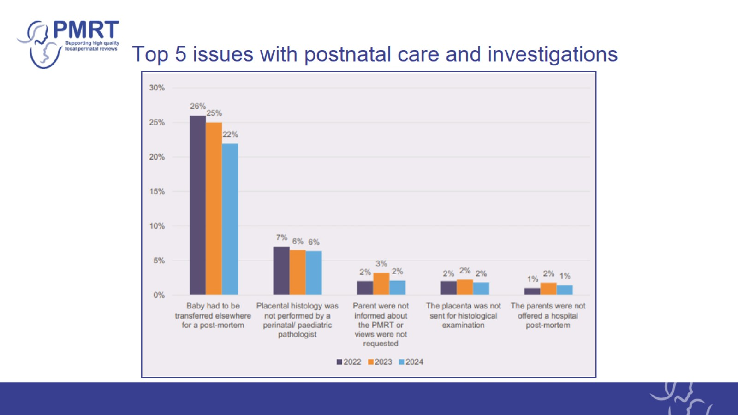
Top 5 issues with postnatal care and investigations

Slide 18
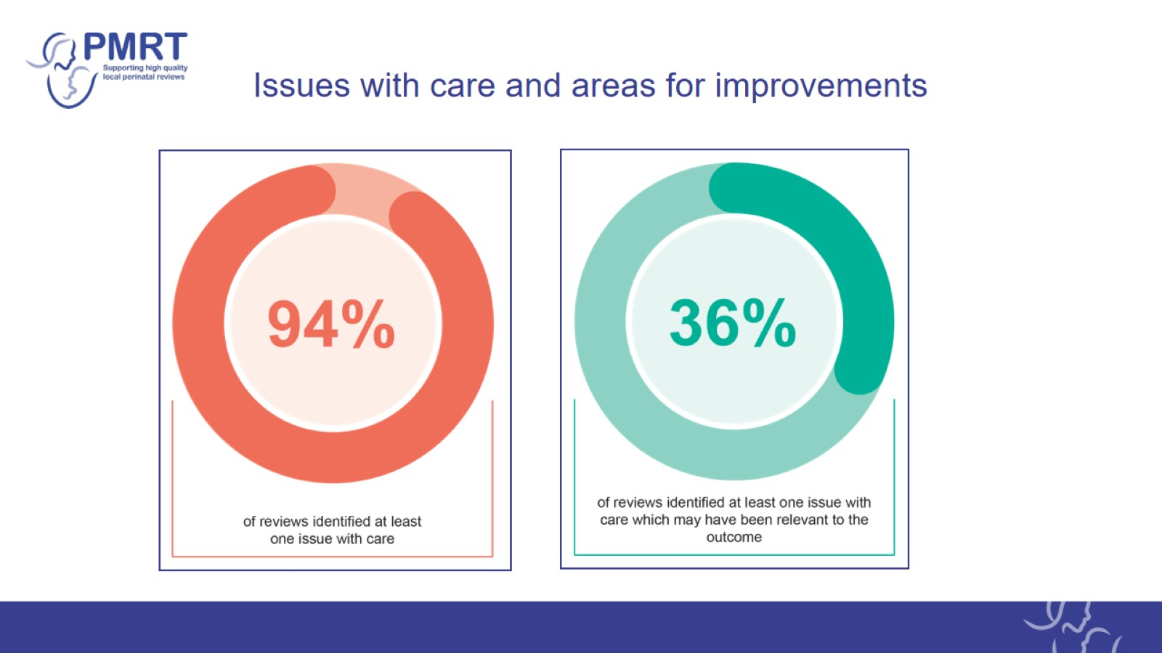
Issues with care and areas for improvements

Slide 19
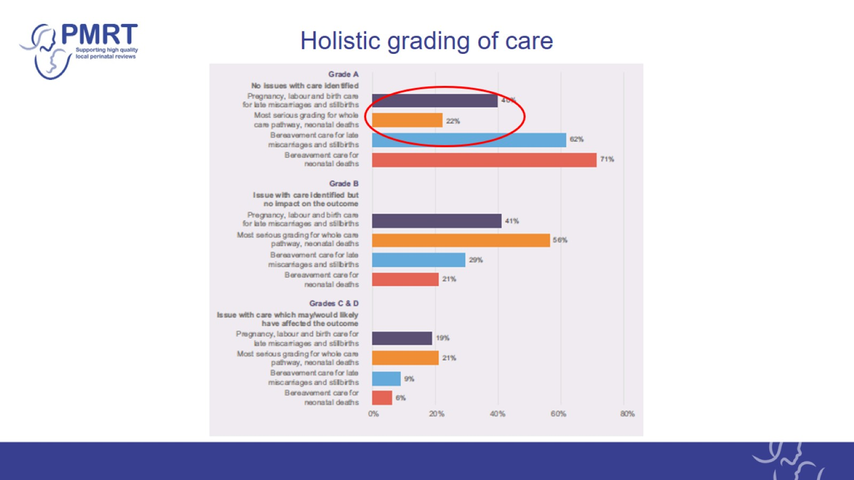
Holistic grading of care

Slide 20
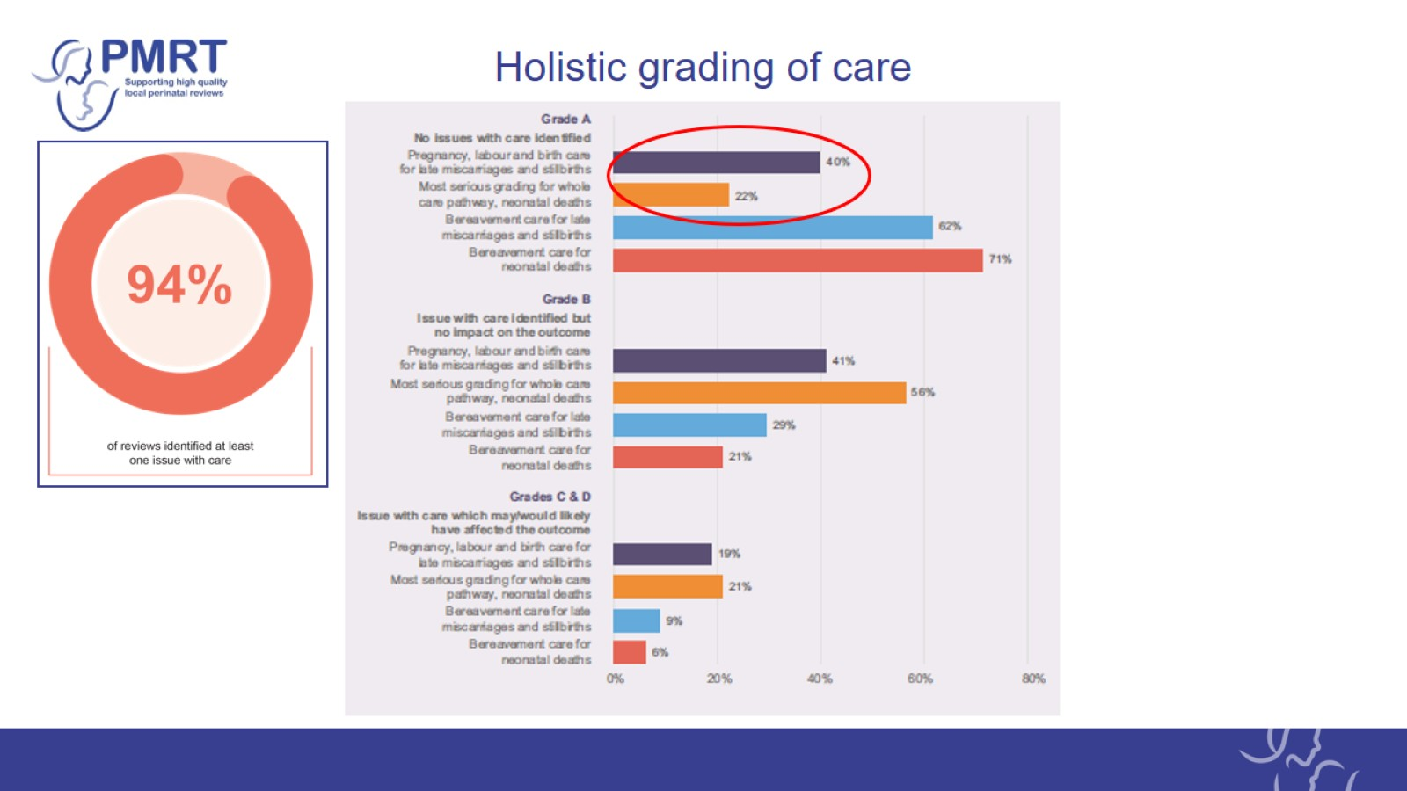
Holistic grading of care

Slide 21
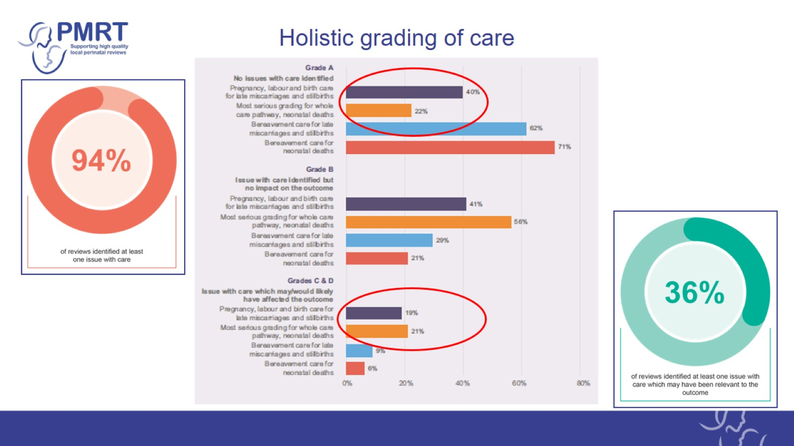
Holistic grading of care

Slide 22
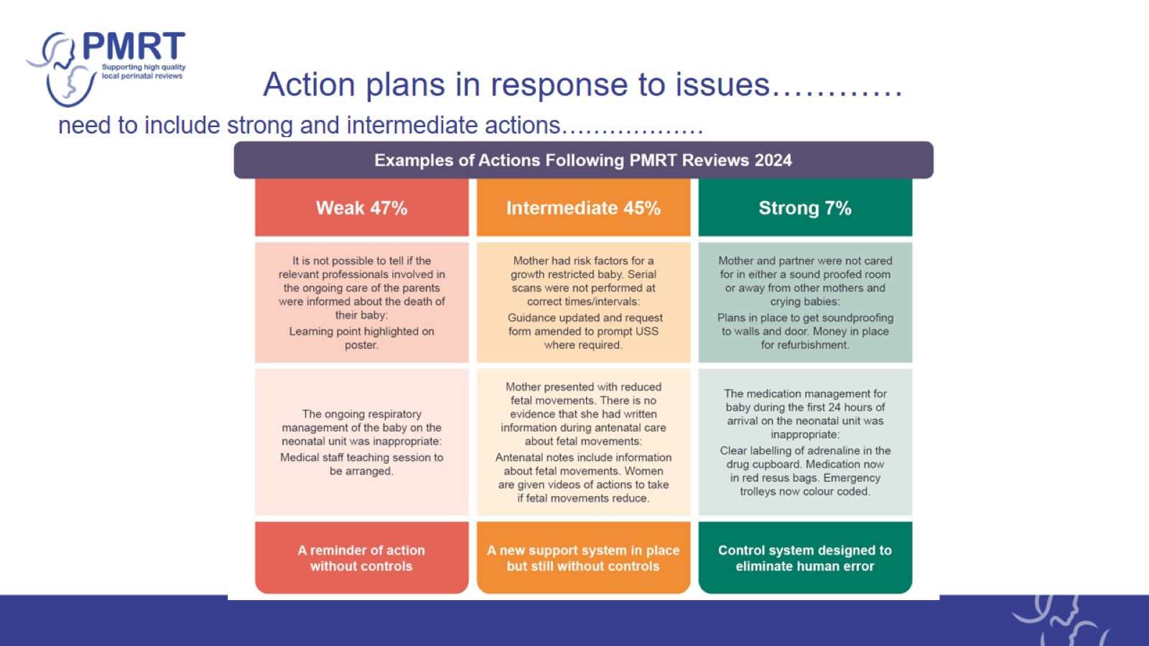
Action plans in response to issues…………

Slide 23
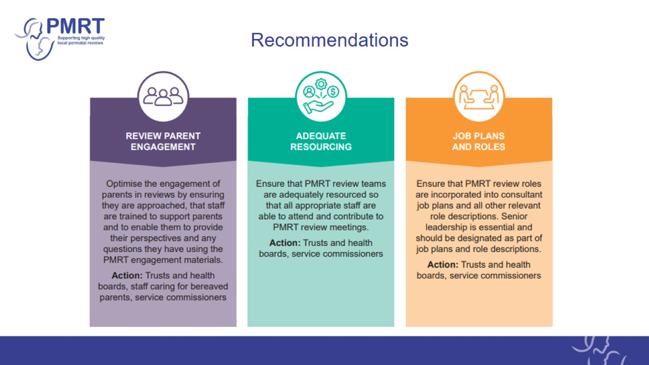
Recommendations

Slide 24
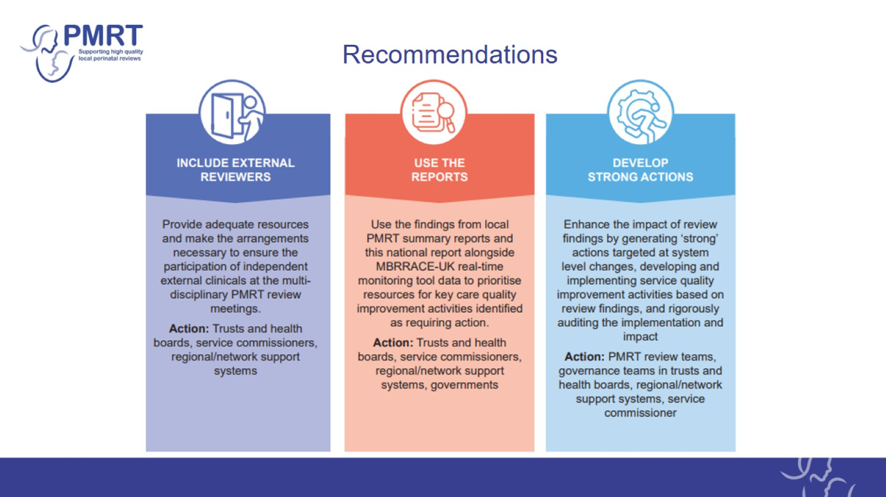
Recommendations

Slide 25
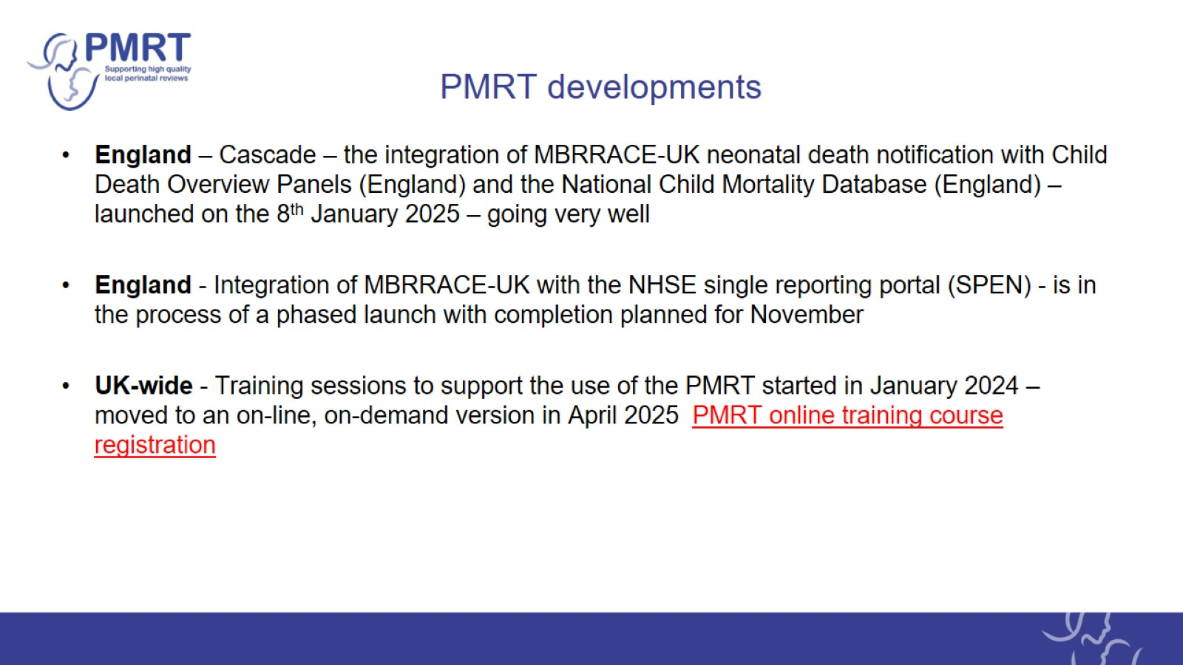
PMRT developments

Slide 26

Acknowledgements

Slide 27

MBRRACE-UK/PMRT collaboration

Slide 28
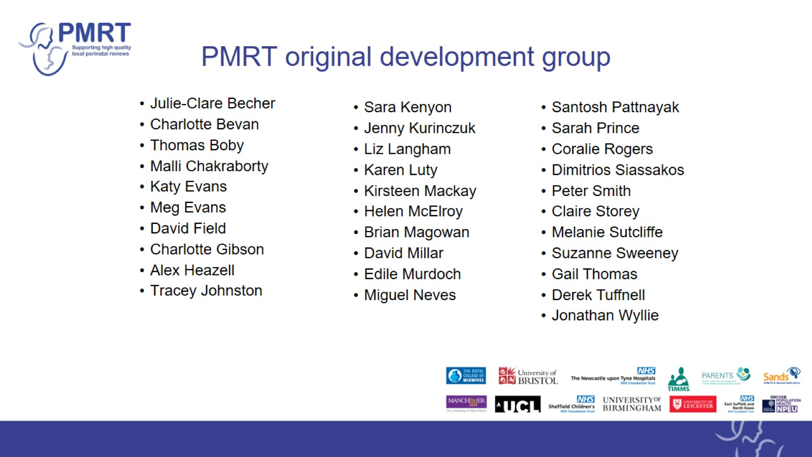
PMRT original development group

